Slide 1


Introduction to Java
Chapter No. : 1
Notes:
‹#›

Slide 2


Topic Learning Outcomes
Explain java object oriented programming concepts
Explain java platform features
Explain primitive data types in Java
Write java programs using arrays and strings
Analyze and draw class diagrams using UML notations for the given scenario
PS : These topics are primitive steps in understanding Object Oriented Programming.
School of Computer Science & Engineering
Notes:
‹#›

Slide 3
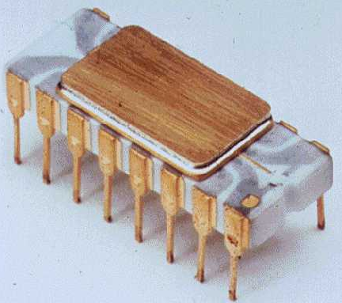
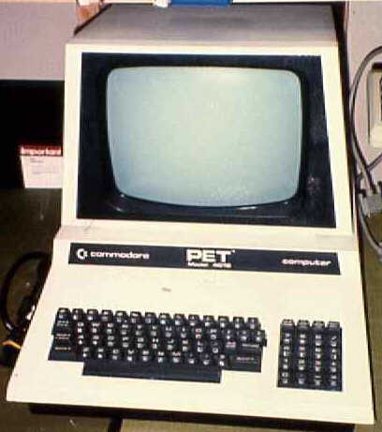
Java History
The invention of the microprocessor revolutionized computers
Intel microprocessor
Commodore Pet microcomputer
School of Computer Science & Engineering
Notes:
‹#›

Slide 4
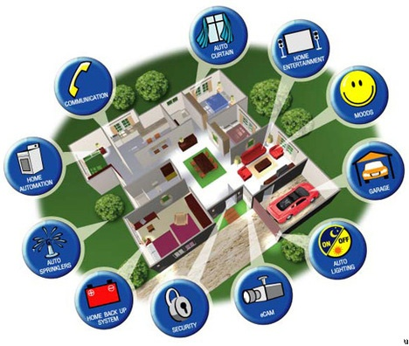
Java History
It was believed that the logical next step for microprocessors was to have them run intelligent consumer electronics
School of Computer Science & Engineering
Notes:
‹#›

Slide 5
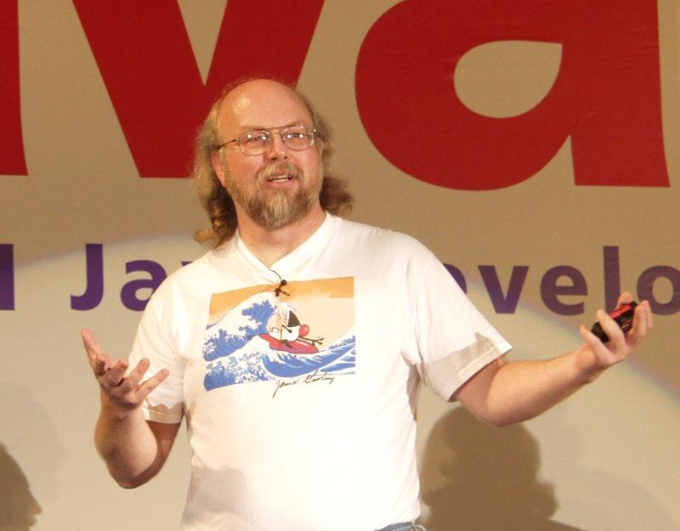
Java History
Sun Microsystems funded an internal research project “Green” to investigate this opportunity.
Result: A programming language called “Oak”
Blatant advertisement: James Gosling was a graduate of the U of C Computer Science program.
Best Known as Father of Java Programming Language
© Fox, Image from the website of Sun Microsystems
School of Computer Science & Engineering
Notes:
‹#›

Slide 6
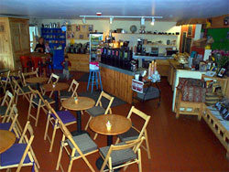

Java History
Problem : There was already a programming language called Oak.
The “Green” team met at a local coffee shop to come up with another name... Java!
School of Computer Science & Engineering
Notes:
‹#›

Slide 7

Java History
The concept of intelligent devices didn’t catch on.
Project Green and work on the Java language was nearly canceled.
School of Computer Science & Engineering
Notes:
‹#›

Slide 8

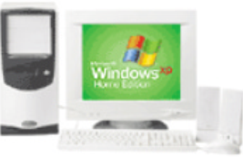
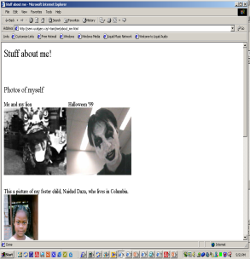
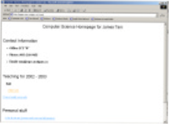
Java History
The popularity of the Internet resulted in Sun’s re-focusing of Java on computers.
Prior to the advent of Java, web pages allowed you to download only text and images.
Your computer at home running a web browser
Server containing a
web page
User clicks on a link
Images and text get downloaded
School of Computer Science & Engineering

Slide 9
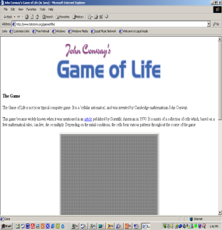
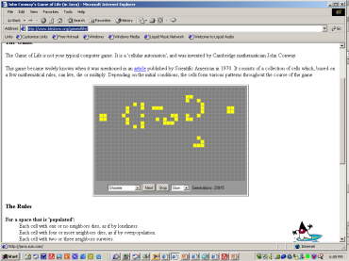
Java: History
Java enabled web browsers allowed for the downloading of programs (Applets).
Java is still used in this context today:
Your computer at home running a web browser
Server containing a web page
User clicks on a link
Java Applet downloaded
School of Computer Science & Engineering

Slide 10
Features Of JAVA
Java is simple
Java is object-oriented
Java is distributed
Java is interpreted
Java is robust
Java is secure
Java is architecture-neutral
Java is portable
Java’s performance
Java is multithreaded
Java is dynamic
School of Computer Science & Engineering

Slide 11
JAVA Development Kit
Java 7+ JDK (Java Development Kit), Standard Edition includes:
JDK (Java development kit) – for developing Java software (creating Java programs).
JRE (Java Runtime environment) – only good for running pre-created Java programs.
Java Plug-in – a special version of the JRE designed to run through web browsers.
School of Computer Science & Engineering

Slide 12
Java Development Kit
javadoc
javac
Javah
Java
jdb
Text Editor
Java Source Code
javadoc
HTML Files
Javac
Java class File
javah
Header Files
java
jdb
Java Program output
School of Computer Science & Engineering

Slide 13
Introduction: java programming
Configuration of Java program execution environment
PATH : Environment variable
Java program structure
Program = code + data
Data types
Primitive types: Integer type, floating, char
Non-primitive types : array, string, class and interface
Code: Programming constructs
Key words: 50
Control statements
Iterative statements
Operators: Logical, relational and arithmetic
Coding standards: Pascal and Camel notation
Reading input to java programs: command Line, Scanner object
Array in java
School of Computer Science & Engineering

Slide 14
Introduction: java programming : Key words
abstract default implements this
assert do import true
boolean double instanceof throw
break else int throws
byte enum interface while
case extends long return
catch false new short
char final null static
class finally package
float private
continue for super
School of Computer Science & Engineering

Slide 15
Introduction: java programming: Data types
Integer Type Memory in bytes
byte 1
short 2
int 4
long 8
Floating Type
float 4
double 8
Textual
char 2 (Unicode character)
Logical
Boolean 1
School of Computer Science & Engineering

Slide 16
Introduction: java programming: Coding standards
Set of guidelines
Enhance the readability and clarity of the program
Make it easy to debug and maintain the program
Class name: Should follow Pascal Case
i. First letter should be Upper case
ii. First letter of each internal word should be capitalized (if it is present)
Instance variable, Reference Variable & method name i. First letter should be lower case
ii. . First letter of each internal word should be capitalized (if it is present)
School of Computer Science & Engineering

Slide 17
Introduction: java programming: program structure
[package statement;]
[import statements;]
[Interface definition]
[class definition]
class classname // starter class
{
public static void main(String[] args)
{
// code
}
}
School of Computer Science & Engineering

Slide 18
Introduction: java programming: Example
// starter class or test program
class HelloWorld
{
public static void main(String[] args)
{
System.out.println(“Hello world”);
}
}
School of Computer Science & Engineering

Slide 19
Introduction: java programming: Reading input from console
class CmdArgumentsDemo
{
public static void main(String[] args)
{
// prints first element
System.out.println(args[0]);
for(int i=0;i<args.length;i++)
{
System.out.println(args[i]);
}
//foreach version in java
/*
for(String s: args)
{
System.out.println(s);
}*/
}
}
School of Computer Science & Engineering

Slide 20
Introduction: java programming: Assignment
Write a java program to read two numbers from user and display sum. Use command line arguments
School of Computer Science & Engineering

